Slide 1
Preview and Give Us Your Input on the New NDE School-Family-Community Engagement Framework Kim Larson, NDE
Session Facilitators:
Jessica Boren, Nebraska Statewide Family Engagement Centers
Jessie Coffey, NDE
Nicole Everingham, Collective for Youth
Saundra Frerichs, Nebraska Extension
Lindsay Limbach, Lincoln CLC
Dawn Lindsley, Nebraska Extension
Eric Savaiano, Nebraska Appleseed
Russ Uhing, Lincoln Public Schools

Slide 2
Why are we developing a School-Family-Community Engagement Framework?
Guide the work of NDE, Nebraska Schools, Community and Business Partners, and Families as we work together to improve student learning
Provide definition and clarification regarding the AQuESTT Positive Partnerships, Relationships, and Student Success tenet
Support schools in the improvement process (Comprehensive Needs Assessment, Accreditation/CIP initiatives)
COVID-19 reinforced that family and community engagement are essential to student success.

Slide 3
The Process

Slide 4
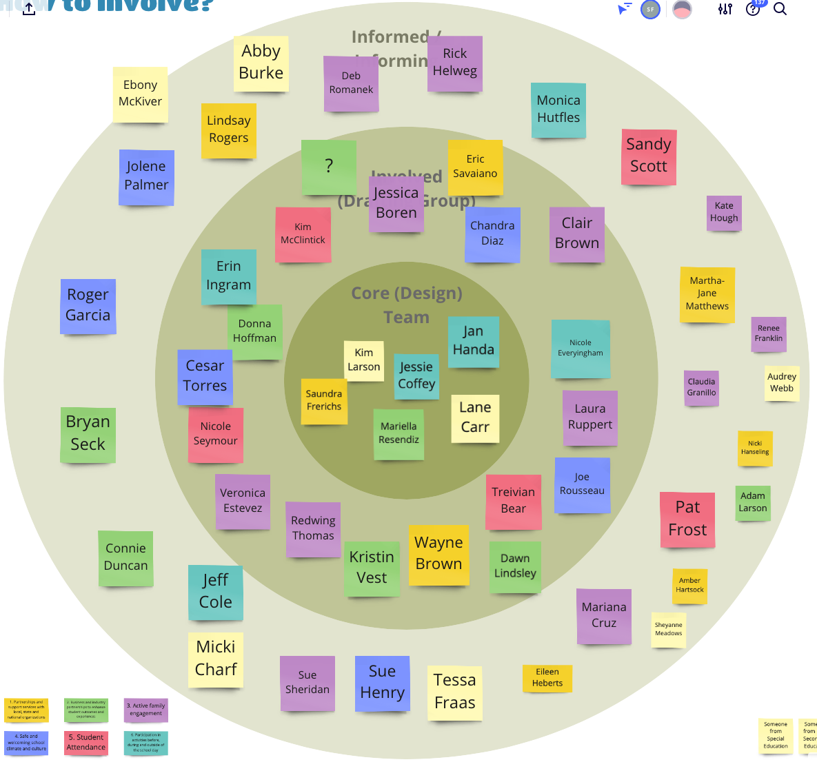
Stakeholders

Slide 5
Framework Audiences

Slide 6
Current Draft Framework
Six Focus Areas
Partnerships and Support Services with local, state, and national organizations
Business and industry partnerships to enhance student outcomes and experiences
Active family engagement
Safe and welcoming school climate and culture
Student attendance
Participation in activities outside of the school day
Five Essential Elements Within Each Focus Area
Definition
Equity
Research
Best Practices
Resources

Slide 7
Review Framework
Review the definitions of each focus area. Feel free to make notes on the document.
Talk with a partner:
What do you like? What is missing? What should be removed, if anything?
Where is additional clarity needed in connecting the framework with the AQuESTT tenant of Positive Partnerships and Relationships?

Slide 8
Small Group Discussion
Knowing this resource is being developed, consider these discussion questions which will inform our work:
1. What information should be available in this Framework?
2. How would you use the information provided in the Framework?
3. Do you know of current programs/projects within your district that could be showcased on the NDE Framework website as examples of excellence?
Add your questions, comments and contact information.

Slide 9
Next Steps
Drafting team will consider your input from today in the next revision
Gather input from additional stakeholders
Begin capturing exemplary examples of practice from across the state to showcase on the Framework website

Slide 10
Thank you for your input!
Please stay in touch!
Jessica Boren, jboren@familieslearning.org
Jessie Coffey, jessie.coffey@nebraska.gov
Nicole Everingham, neveringham@collectiveforyouth.org
Saundra Frerichs, sfrerichs3@unl.edu
Kim Larson, kim.larson@nebraska.gov
Lindsay Limbach, llimbach@lps.org
Dawn Lindsley, dawn.lindsley@unl.edu
Eric Savaiano, esavaiano@neappleseed.org
Russ Uhing, ruhing@lps.org

