Slide 1
It Starts With a Plan: Components and Considerations for HAL Programs
Sheyanne Meadows, High Ability Learning Specialist
Nebraska Department of Education
July 28, 2021

Slide 2
https://bit.ly/halndeday

Slide 3
What comes to mind when you hear “High Ability Learner”?
Notes:
https://bit.ly/halintro

Slide 4
Definition of HAL
Nebraska:
“Learner with high ability means a student who gives evidence of high performance capability in such areas as intellectual, creative, or artistic capacity or in a specific academic fields and who requires accelerated or differentiated curriculum programs in order to develop those capabilities fully.” (Rule 3)
National Association for Gifted Children
“Students with gifts and talents perform—or have the capability to perform—at higher levels compared to others of the same age, experience, and environment in one or more domains. They require modification(s) to their educational experience(s) to learn and realize their potential…”

Slide 5
Characteristics of HALs
Ability to learn quickly and with relative ease
Verbal proficiency
Relates to older children and adults
Unusual imagination
Absorbs knowledge and memorizes easily
Deep interest in a single area OR variety of interests
Creativity and inventiveness
Sensitive; empathy for others
Curiosity
National Association for Gifted Children

Slide 6
Less Traditional Characteristics
Refuses to do homework (bored with task)
Difficulty changing topics
Impatient with others
Questions adults
Over-sensitive/Emotional; overreacts
Stubborn with authority
Bossy; Dominates conversation
Talks with teacher often
National Association for Gifted Children

Slide 7
Turn and Talk!
On a scale of 1-5, how much of a priority is serving HAL students in your district?

Slide 8
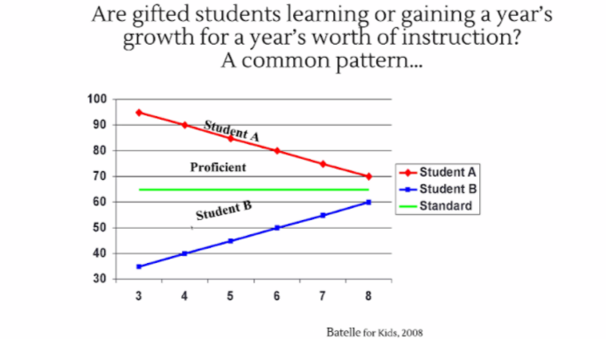
Why Is It Important to Why Is It Important?
Students who perform at the highest levels make little to no growth.
“…possible explanations include lack of opportunity for high-scoring students to proceed at their own pace, lack of challenging materials, lack of accelerated course offerings, and concentration of instruction on the average or below-average student. This finding indicates that it cannot be assumed that higher-achieving students will "make it on their own.“
Wright et. al, 1997
“Gifted students have special needs; they are at risk of learning the least in the classroom.”
Choice & Walker, 2017

Slide 9
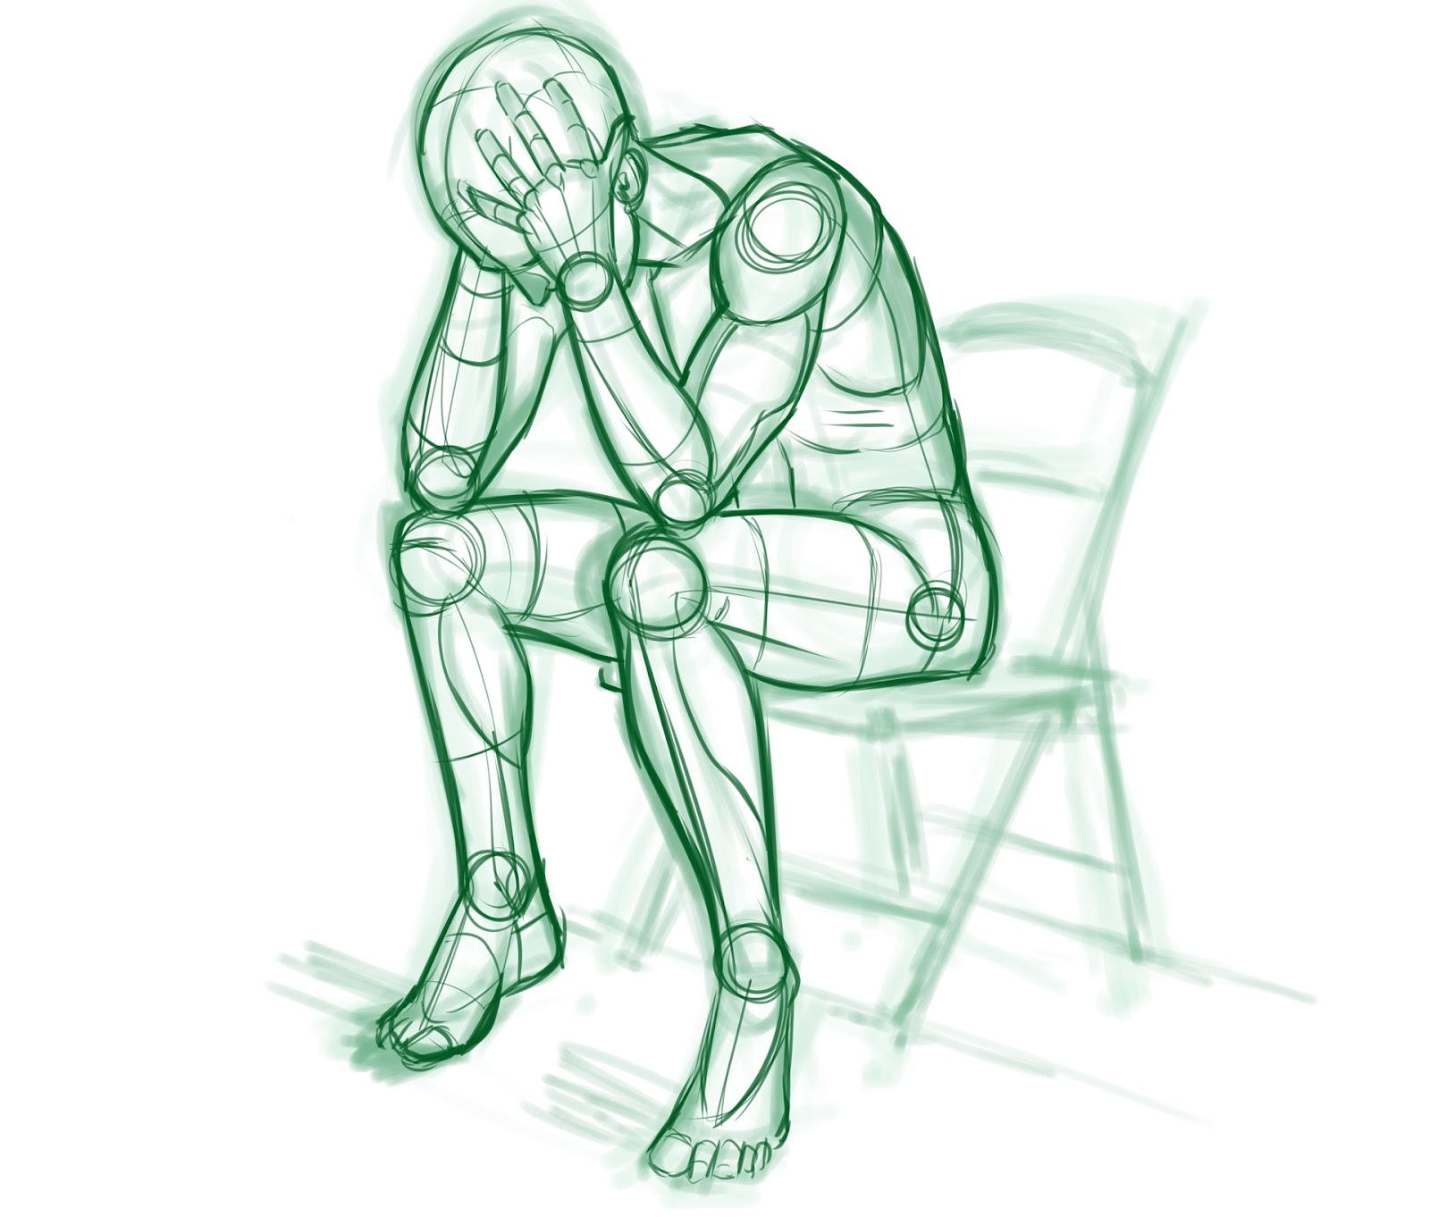
Why Is it Important? (cont.)
Affective Implications:
Underachievement
Poor attitude toward school
Social isolation
Boredom
Disruptive behaviors

Slide 10
Creating/Revising a HAL Plan for Your District
Notes:
Where do we start? It can feel overwhelming when thinking about serving HAL students. One place we can start is with a solid foundation: a plan.

Slide 11
Requirements from Rule 3
Approved plans shall include:
District’s philosophy on educational services to learners with high ability
Operational definition of high ability learner
Goals and objectives of the program
Procedures for identification
Description of continuum of services, options, and strategies
Program evaluation process
Staff development training and support
Program management outline (personnel, communication plan, budget, etc.)
Must be available to citizens of the district
PLANS ARE NOT AN OPTION
Nebraska Department of Education Rule 3: Regulations Governing High Ability Learners, 1998

Slide 12
Philosophy/Mission Statement
Use clear language to articulate the commitment to meeting the needs of all learners—including learners with high ability, who may need additional services to meet their potential
Jargon-free
Clear and accessible to all stakeholders
Speirs Neumeister & Burney, 2019

Slide 13
Example of a Philosophy/Mission Statement
Example Schools recognizes that each student is a unique. We strive to provide high-quality instruction to all students and also take into account their individual needs.
The purpose of the High Ability Learner program is to provide an inclusive environment and create opportunities for students to develop talents in their domain of strength while focusing on the specific affective, social, and academic needs of gifted and talented students.
The High Ability Learner program is designed to identify students in grades K-12 who exhibit high performance capabilities and foster talent in students that display potential. Appropriate services shall be provided to these students.

Slide 14
Definition of “High Ability Learner”
How your district defines what a constitutes a high ability learner
Should reflect your district’s capacity to serve
From Nebraska Rule 3:
“Learner with High Ability means a student who gives evidence of high performance capability in such areas as intellectual, creative, or artistic capacity or in specific academic fields and who requires accelerated or differentiated curriculum programs in order to develop those capabilities fully.” (1998)

Slide 15
Goals and Objectives for the Program
Clear statements of what the intentions of the program
What will students be able to do as a result of the HAL program?
Should be evaluable

Slide 16
● The goal of Example School’s HAL Program is to provide learning opportunities to HAL students in order for them to actualize their potential and make growth commensurate with their abilities.
● Identify students who demonstrate potential abilities of high performance in ELA, Math, and Leadership Follow the identification procedures as outlined in the district identification plan for high ability learners.
○ All staff members shall be made aware of the identification procedures.
● Provide education services that meet the needs of all high ability learners.
○ Within the regular classroom a variety of instructional techniques including but not limited to compacting, alternative assignments, advanced placement, contract learning, differentiated curriculum, and independent studies will be used as necessary.
○ Within the regular classroom flexible grouping, including but not limited to ability, achievement, cluster, and cross-age grouping will be provided as necessary.
○ Enrichment programs will include but are not limited to within-class enrichment, whole class enrichment, before and after school enrichment, field trips, school-wide enrichment, learning centers, extracurricular programs, community sponsored programs, and pull-out services.
○ To evaluate student program option choices on an individual basis at the discretion of the classroom teacher in conjunction with the HAL coordinators.
● Provide professional development opportunities to staff in order to promote a better understanding of the needs of high ability learners, and the services available to meet those needs.

Slide 17
Procedures for Identification
Speirs Neumeister & Burney, 2019
Notes:
Highlights the complexity of gifted learners

Slide 18
Procedures for Identification (cont.)
Assessment measures
Recommendations
Qualitative measures or scales
Selection procedures
Qualification criteria

Slide 19
Procedures for Identification (cont.)
Identification should align to available services
Multifaceted
Reliable and Valid Assessment Measures
Highlight equitable identification practices
Demographics should be reflective of the school population; multiple measures; opportunities for all
Renzulli, 2005; Speirs Neumeister & Burney, 2019
Notes:
ID should align to services. ID in an area not served does not help the student. If a student is ID in math and the school only services ELA, it will not be appropriate for the student
Multifaceted means testing multiple things (achievement, potential, qualitative, etc.)
Reliable and valid. For example, teacher scales are least reliable, and tests such as MAP and CogAT would be most reliable
Equitable practices: multiple measures, all students have access to candidate pool; identifies proportionately

Slide 20
Identification Procedures Example
All students in Example Schools will be screened in grades K-12 for our district’s high ability services based on the following:
In 3rd grade, all students will be administered the CoGAT for Universal Screening.
MAP Reading and/or Math Achievement test scores of 90th percentile or higher
Teacher Perception Ratings using a HAL characteristic form
Self, parent, peer, and teacher nomination forms
IQ Testing upon request
Students who have a score at the 90th percentile or higher on the Fall Reading and Math MAP test and/or the Winter Reading and Math MAP test will be considered for gifted and talented services.
Other indicators may be included: other test scores, checklists, and etc.

Slide 21
Identification Procedures Example (cont.)
After the screening process, students will be placed in a candidate pool. These candidates will complete a self-rating scale, teachers will complete an identification form, and parents will complete a parent form. After examining all of the data in a matrix, a determination will be made. If it is determined that the student will not be eligible for gifted services, a team must meet to review all of the data to ensure the correct decision is being made and send a letter to the parent or guardian.
Notes:
As shown, this ID procedure uses all of the fields required (testing, qualitative measures and scales, recommendation, selection criteria)

Slide 22
Questions?

Slide 23
Share with a partner: Out of the topics discussed, what is the strongest area of your HAL plan?

Slide 24
Description of Services
List of HAL services, curricular or instructional interventions, etc. used in the district.
Acceleration
Curriculum Enrichment
Flexible Grouping
Curriculum Compacting
Advanced Placement
Advanced Elective Classes
Independent Study Opportunities
SEBL Interventions
Dual Enrollment
Cluster Grouping
Mentorships/Shadowing
Extra-Curricular School Offerings
Counseling & Guidance
Career Exploration
Pull-Out
Push-In

Slide 25
Program Evaluation Process
Examines overall effectiveness of the program by analyzing student outcomes
Program Cohesion
Opportunity for stakeholder feedback
Gives guidance for future direction
Notes:
Effectiveness for students in cognitive and affective realms
Program cohesion is internal consistency and continuity. For example, does ID match services? Are all elements of the program aligned and build vertically?
Stakeholder perceptions of the program are important and can provide insight.

Slide 26
Speirs Neumeister & Burney, 2019

Slide 27
Program Evaluation Process Example
Annual evaluations of the HAL program shall be conducted by using any of the following measures:
Surveys
Interviews with staff, students, and stakeholders
Student data (test scores, surveys, products, etc.)
Program documents (ID forms, protocols, etc.)
Information gathered will be used to determine the strengths and weaknesses of the HAL program and how we can improve. Student needs, program design, curriculum, learning environment, student identification, staff development, and other resources will be evaluated.

Slide 28
Staff Development Training and Support
65% of teachers reported that they received little to no preparation for meeting the needs of students who met grade-level expectations in their pre-service programs.
Properly identifying and serving HAL students starts with comprehensive professional learning.
Some areas of PL include;
Foundations of gifted education
Characteristics and learning differences of learners with high ability
Instructional strategies
Instructional planning
Assessment
Collaboration
Farkas & Duffett, 2008; NAGC & CEC-TAG, 2013

Slide 29
Staff Development Example
School staff shall receive training at least 2 times per year, which will include, but is not limited to areas such as HAL characteristics, social and emotional needs, identification, curriculum, assessment techniques and instructional strategies.
Teachers will be encouraged to attend seminars and conferences related to high ability learning (i.e. Nebraska Association for Gifted conference, ESU workshops, Webinars, etc.).
Teachers, counselors, and administrators will be made aware annually, which students have been identified and are included in the program.
Notes:
Based on your program eval or survey of teachers, you can be more specific with PL

Slide 30
Program Management
Roles and responsibilities of key individuals and groups
This includes, but is not limited to:
District administrator
Building administrator
HAL facilitator
Classroom teacher

Slide 31
Speirs Neumesiter & Burney, 2019
Notes:
Graphic of role example

Slide 32
Reflection
What is one take-away that you will apply in your district to write/revise your HAL plan?

Slide 33
“Someone’s sitting in the shade today because someone planted a tree a long time ago.” – Warren Buffett

Slide 34
Thank you! sheyanne.meadows@nebraska.gov https://www.education.ne.gov/hal/
@NDE_HAL

