Slide 1
Copying and Pasting is not Enough for a Bullying Policy
Cesar Torres

Slide 2
Litigation is Expensive
Nebraska 2017-2018:
472 reports made to office of civil rights based on bullying or harassment (USDOE, 2021)
Examples of Lawsuits in Nebraska:
$650,000 lawsuit against school for oversight
$3.275 million lawsuit for failing to respond and protect based on IDEA
$75,000 lawsuit for IDEA and for a staff member bullying a student
Notes:
https://www.huffpost.com/entry/roxana-spady-nebraska-mot_n_933060
https://www.publicjustice.net/wp-content/uploads/2018/01/2018.01.08-Winter-2017-Edition-Bullying-Verdicts-and-Settlements-Final.pdf

Slide 3
Bullying Behavior
Outcomes: Physical injury, sleep difficulties, lower academic achievement, and dropping out of school.
Risk: Substance use, academic problems, and experiencing violence in adolescence and adulthood.
Public Health Problem: Association with mental health and behavioral problems
Cyber-Bullying
High school (30%)
Middle school (33%)
Primary schools (5%)

Slide 4
Statue 79-2,137
School district; development and adoption of bullying prevention and education policy; review.
(1) The Legislature finds and declares that:
(a) Bullying disrupts a school's ability to educate students; and
(b) Bullying threatens public safety by creating an atmosphere in which such behavior can escalate into violence.
(2) For purposes of this section, bullying means any ongoing pattern of physical, verbal, or electronic abuse on school grounds, in a vehicle owned, leased, or contracted by a school being used for a school purpose by a school employee or his or her designee, or at school-sponsored activities or school-sponsored athletic events.
(3) On or before July 1, 2009, each school district as defined in section 79-101 shall develop and adopt a policy concerning bullying prevention and education for all students.
(4) The school district shall review the policy annually

Slide 6
Qualitative Study
Current Research
Educational polices in relation to student outcomes are rarely studied.
Available Studies
Zero tolerance
Vagueness
Collaboration
Notes:
Swearer, 2012, Wang 2018, Berkman Center at Harvard University, 2013

Slide 7
Themes of Nebraska Bullying Policies
Definitions
Wrong definitions
Vagueness
Unclear education
Bullying = harassment = sexual harassment
No definitions
Policy spread across multiple policies
Specific Populations
Teacher roles
Title X protections
Logistics
Not reviewed annually
Disconnect between handbook and policy
Copying and Pasting

Slide 8
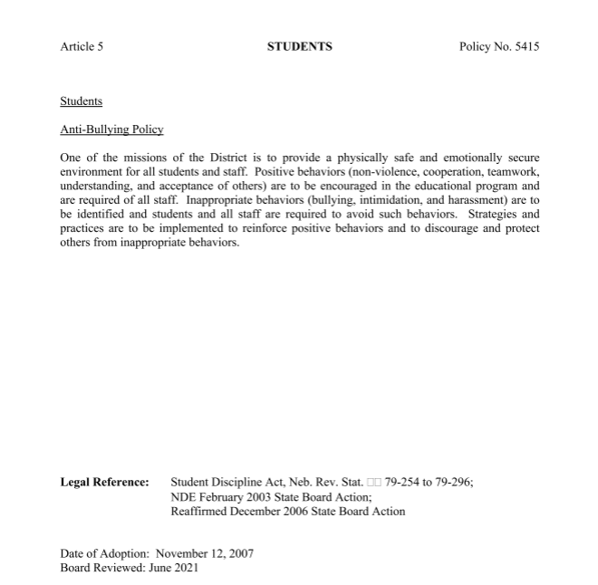
No Definition Bullying=intimidation =harassment Very old No Title X statement

Slide 9
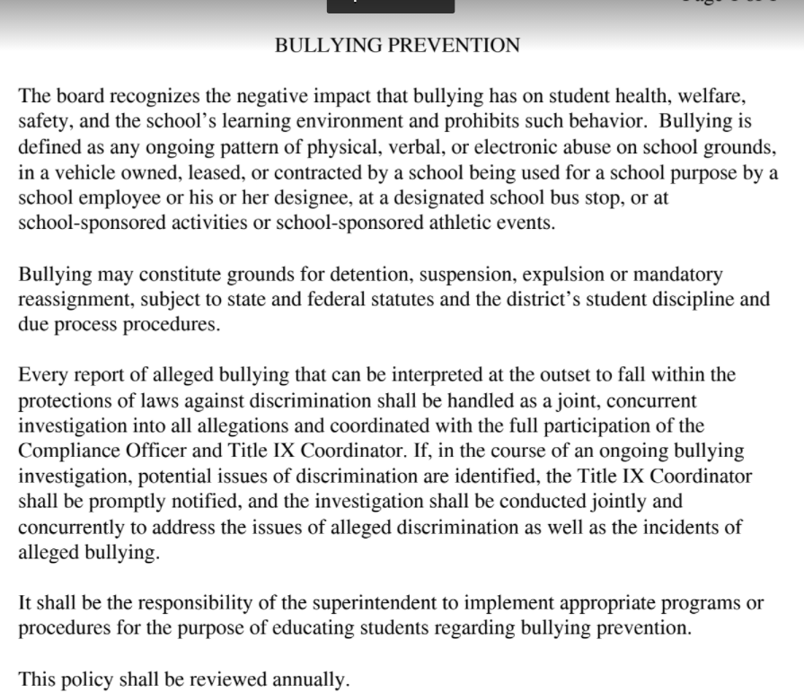
Wrong Definition Zero Tolerance Vague Education

Slide 10
No Definitions Not Revised Annually

Slide 11
On the Bright Side

Slide 12
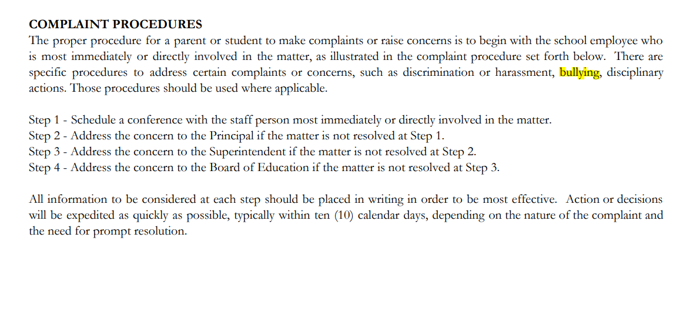
Reporting Procedures

Slide 13
Inclusion of cyber-bullying Plan

Slide 14
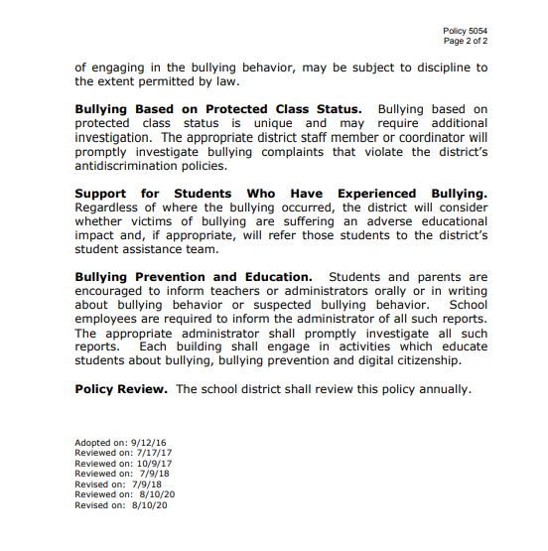
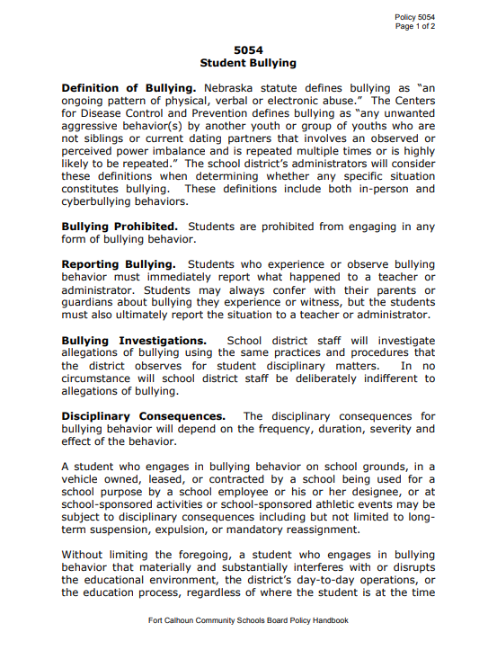
Great Components

Slide 15
Research
Hall, 2017

Slide 16
Essential Components
1. Clear Definitions
2. Anonymous Reporting
3. Bullying Investigation
10. Reviewed Annually
4. Adaptive Consequences
5. Addresses Biased-Based Bullying
6. Clear Education
7. Home School Communication
8. Policy for Educators
9. Grievance Procedures

Slide 17
Components 1
Clear definitions of bullying and cyber-bullying
Includes CDC and State Definition
Anonymous reporting
Includes a non retaliation statement
Bullying investigation
Procedure clearly defined

Slide 18
Components 2
Discipline
Adaptive consequences
Bias
Address biased-based bullying
Education
Clear bullying prevention and education on a school-wide, classroom, and individual basis.
Zero-Tolerance does not work
Emphasis on student safety
Supports, accountability, and education
Title X statement
IDEA and FERPA
Focused on building relationships
Developmentally appropriate education

Slide 19
Components 3
Communication
Communication and dissemination of policy
Educators
Training
Review
Engagement
Reviewed and/ or updated annually
Grievance
Procedures for parents
When staff bully others and are bullied
Steps to follow when parents disagree with school

Slide 20
Implementation
Training
Includes students, teachers & parents
Consistent Language
Language in handbook
Handbook for implementing policy
Data
Data informed decisions
Tracking progress
Evidence

Slide 21
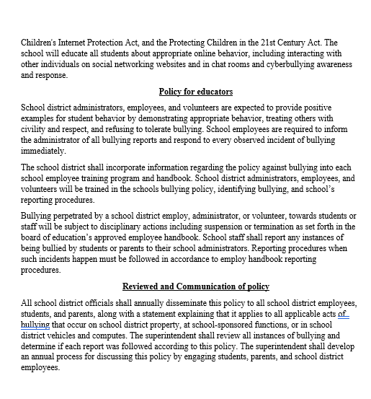
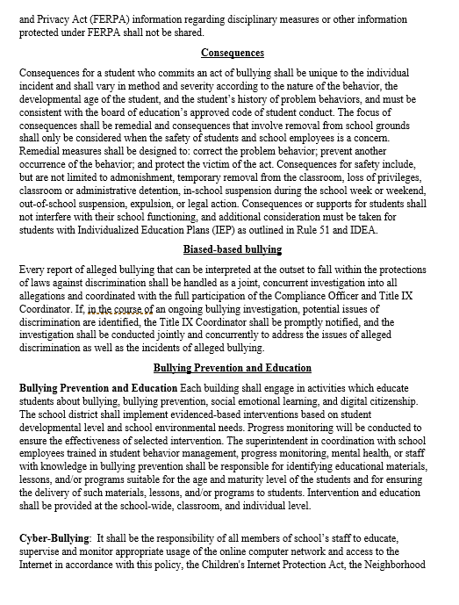
Example of Bullying Policy

Slide 22
Resources
Nebraska School Safety – Nebraska Department of Education
What Is Bullying | StopBullying.gov
Cyberbullying Research Center - How to Identify, Prevent and Respond
Target Bullying Involvement Program | College of Education and Human Sciences (unl.edu)
The Trevor Project — Saving Young LGBTQ Lives

Slide 23
Thank You!

