Slide 1
State of Nebraska CTE
Sydney Kobza
Assistant Director, Nebraska Career and Technical Education

Slide 2
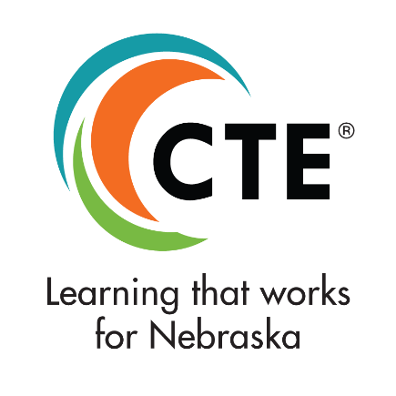
Nebraska Career and Technical Education helps lead and support the preparation of all Nebraskans for learning, earning, and living!

Slide 3
Guiding Principles of Nebraska CTE
Relevant
Nebraska CTE Data
Innovative
ReVision
Perkins Updates
Rule 47 Career Academies
Coordinated
Standards Revision Process
Equitable
Access to High Quality CTE Programs

Slide 4
Relevant

Slide 5
The Majority of Learners in Nebraska Participate in CTE!
Students Grades 7-12
80%
30%
of students grades 7-12 participate in CTE.
of high school students are CTE concentrators
*Preliminary 20-21 data
Notes:
To kick things off I thought it would be helpful to share some updated data points about CTE in our state.
First thing of note – the majority of learners in NE participate in CTE! AS you can see here, of the 143,812 students in the state grade 7-12, this past year just over 115,000, or 80% took at least one CTE course. And of those students, about 30% took two or more classes within a program of study at the intermediate or capstone level, making them a CTE concentrator.

Slide 6
School Districts Offering at Least One Program of Study by Career Field
*244 Total School Districts in Nebraska
*Preliminary 20-21 data
Notes:
On this slide you can see the number of school districts who are offering at least one program of study within each of the six career fields. As a reminder, we have 244 school districts in the state.

Slide 7
Student Participation by Career Cluster
*Preliminary 20-21 data
Notes:
Here you can see how many students are taking courses within each of the 16 career clusters.

Slide 8
Among all learner groups, those who concentrate in CTE graduate high school at higher rates.
93%
88%
*2019-2020
Notes:
Moving on to some outcome data – you can see here that among all learner groups, those students who are concentrating in CTE graduate high school at higher rates. Across all learner groups, it’s about 93%, whereas the state average was 88%.
I like analyzing data like these to illustrate that when 80% of students in the state are taking CTE courses, CTE courses then serve all learners.
Take a look at the outcomes for learners with disabilities or learners from low-income families. This illustrates, as an example, that learners with disablities across the state had a graduate rate of approximately 65%. However, for those students with disabilities who were CTE concentrators, their graduate rate was 80%.

Slide 9
CTE Learners Go On To Succeed!
After High School Graduation:
84%
44% four-year college
28% two-year college
of CTE concentrators were enrolled in some form of postsecondary education and training
Nebraska average, all learners 73%
13%
2%
were employed
were in the military
*2019-2020
Notes:
We also see that CTE learners go on to succeed after high school!
You can see here that within 2 quarters after high school graduation, 84% of CTE concentrators were enrolled in some form of postsecondary education (you can see the 2- and 4-year split.
13% were employed and 2% were in the military.

Slide 10
Career and Technical Student Organizations
19,500+
About one out of every six CTE students gained leadership skills by participating in Career & Technical Student Organizations
*2020-2021
Notes:
And of course, our programs continue to be enhanced by our expanded learning opportunities through Career and Technical Student organizations. Last year almost 20,000 students developed academic, technical, and leadership skills by participating in a CTSO.

Slide 11
Secondary CTE participation rates are growing, but some learner groups are underrepresented
*2019-2020
Notes:
It is important to note, however, that while Secondary CTE participation rates are growing, some learner groups are still underrepresented, which you can see here. Compared to the state, we have some learner groups that are moderately overrepresented in CTE Programs and others greatly underrepresented. As we consider equitable opportunities for all learners, it’s important to examine who is participating in these programs, what barriers may exist to participation, and of course, the knowledge and skills gained as a result of participation.

Slide 12
Newly Released! Nebraska CTE Impact Study
Compared educational outcomes of CTE concentrators and non-CTE concentrators in Nebraska and South Dakota
Sample included 112,764 students whose four-year graduation year was between 2012/13 and 2016/17
Notes:
Speaking of outcomes, I’m excited to share the results of a year-long CTE Impact Study in partnership with REL Central and The South Dakota Department of Education.
This Impact Study examined the impact of secondary CTE on graduation rates and postsecondary enrollment and completion within two- five years. The two primary research questions guiding this work were (1) What is the impact of being a CTE concentrator on high school graduation, two-year and five-year postsecondary enrollment and completion, and type of postsecondary award attained? And (2) How do high school graduation and two-year and five-year postsecondary outcomes vary by career cluster?”

Slide 13
Key Findings
CTE Concentrators were more likely than non-CTE Concentrators to:
Graduate from high school on time and to enroll in postsecondary education. | Earn any kind of postsecondary award within two years of and within five years of their expected high school graduation year. | Attain a postsecondary award up to an associate’s degree within five years of their expected graduation year.
Notes:
With such a lack of empirical CTE research, it’s exciting to share the key findings from the study.
Overall, CTE Concentrators are seven percent more likely to graduate from high school on time
They’re also 10 percent more likely to enroll in postsecondary education within two years of graduating compared to non-CTE concentrators,
You can also see CTE concentrators were more likely than non-CTE concentrators to earn any kind of …. Or Attain….

Slide 14
Finance, Marketing, Health Sciences, and Government & Public Administration had the highest two- and five-year postsecondary enrollment rates.
Regardless of Career Cluster, high school graduation rates were consistently higher for CTE concentrators than non-CTE concentrators.
Transportation, Distribution, and Logistics had the highest two-year award attainment rates.
Notes:
The researchers also found that regardless of the career cluster students concentrated in, high school graduation rates were consistently higher than those learners who were non-CTE concentrators.
Regarding specific career clusters, learners in finance, marketing, health sciences, and government and public administration had the highest two- and five-year postsecondary enrollment rates.
Learners in transportation, distribution and logistics, had the highest two-year postsecondary award attainment rates.
Transition to next slide

Slide 15
Question
What data would be beneficial to your school district?
What additional information would you as a district leader like to know?

Slide 16
Innovation

Slide 17
Close to $1,000,000 in awards last year
Award Announcement after August State Board Meeting for 2021-2022 winners
Projects Happening

Slide 18
Perkins Updates
District Highlights
Innovative Processes
Updated Management Guide
Newsletter
Additional Supports
Upcoming Perkins Information

Slide 19
Rule 47 Career Academies
Rule 47 Information
2020-2021 Rule 47 Approved Career Academy Report
Career Academy Advisory Council

Slide 20
Question
What innovative things are happening in CTE within your districts?
What resources can support or foster additional innovative ideas?

Slide 21
Corrdinated

Slide 22
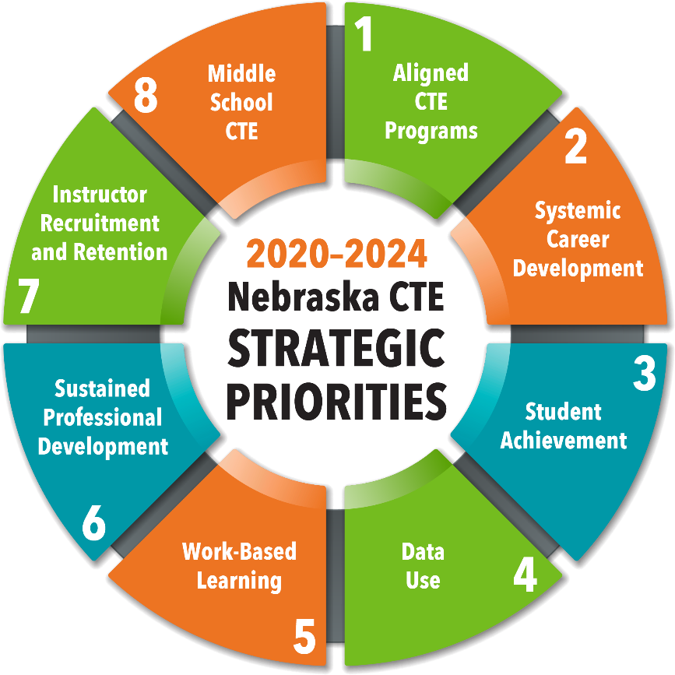
Perkins V Strategic Priorities
Notes:
First and foremost are the eight strategic priorities outlined in our state Perkins V plan. These are the eight areas that we’ll be leaning into over the next four years to move our entire CTE system forward. All of our efforts are intentionally framed around addressing one or more of these statewide priorities.

Slide 23
CTE Standards Revision
Concurrent processes to gather and assess data to inform revised standards.
National and State Policy Scan
Work-based Learning Landscape Analysis
Industry Expert Futuring Panels
Stakeholder Engagement
Notes:
Not the least of which, is our CTE standards revision process taking place right now. For the first time we’re tackling all six CTE content areas simultaneously, which has led to some meaningful conversations about how and where skill development overlaps across career clusters, how career readiness competencies most in demand by employers are similar across industries,, and how expanded learning opportunities allow for more personalized career development.
We’ve enlisted the help of many partners to help ensure we’re setting our students and educators up for success. This has included national and state policy scans, a statewide work-basked learning landscape analysis, and engaging panels of industry experts and other stakeholder groups to share insights into the future of Nebraska’s economy and workforce.

Slide 24
CTE Standards Revision Timeline
Jan | Feb | Mar | Apr | May | June | July | Aug | Sept | Oct | Nov | Dec
Analysis of Nebraska LMI, H3 occupational projections, secondary/ postsecondary alignment
Business Engagement
WBL Landscape Analysis
Futuring Panels
Writing teams draft revised standards
Public Input
Final Revisions
Final Draft
Implementation Planning
Notes:
We’re approaching the mid-way point in this process as you can see here. In just a couple weeks our first teams of writers will begin the revision process. I know many of you are attending this conference are also devoting your time to helping update the standards, so I wanted to acknowledge and thank you again. These collective efforts will ensure our state model programs of study and courses are high-quality, aligned to postsecondary programs and workforce demands, and meet the needs of all learners.

Slide 25
What Comes Next?

Slide 26
Discussion Question
What can the NDE CTE team do to help implement these new standards?
What questions do you have about the standards revision process?

Slide 27
Equitable

Slide 28
Secondary CTE participation rates are growing, but some learner groups are underrepresented
*2019-2020
Notes:
It is important to note, however, that while Secondary CTE participation rates are growing, some learner groups are still underrepresented, which you can see here. Compared to the state, we have some learner groups that are moderately overrepresented in CTE Programs and others greatly underrepresented. As we consider equitable opportunities for all learners, it’s important to examine who is participating in these programs, what barriers may exist to participation, and of course, the knowledge and skills gained as a result of participation.

Slide 29
Equitable
Indicator and Trends Reports
Strategies for Special Population Success
https://www.education.ne.gov/nce/nontraditional-special-populations/
Career and Technical Student Organizations

Slide 30
Question
What areas of support are needed from the NDE CTE team regarding equity?
What are some ways that your district is providing all students access to high quality CTE programs?

Slide 31
Questions?
Sydney Kobza
Assistant Director of Nebraska CTE
Sydney.kobza@nebraska.gov
402-937-3389

Slide 32
Thank You!

