Slide 1
SCHOOL FINANCE UPDATE
Bryce Wilson and Kevin Lyons

Slide 2
Recalculation of 2021-22 Certified SA
Certification of 2021-22 State Aid was certified on March 1, 2021
Fall Membership (from ADVISER – October 1, 2020)
Consolidated Data Collections (from October 30, 2020)
2019-2020 Annual Financial Reports (from November 1, 2020)
Recalculation (begins August 1)
Average Daily Membership (from ADVISER – June 30, 2021)
Amended 2019-2020 Annual Financial Reports (July 15, 2021)
Calculates Prior Year Corrections to be used for 2022-2023 State Aid Certification

Slide 3
LB 528 Changes for ESU and Schools
ESU Core Services and Technology Infrastructure funds will no longer be paid on the first business day of the month as they will now be paid on the last business day of each month beginning in September of each school fiscal year and ending in June.
Core services and technology infrastructure funds shall be adjusted when property within the boundaries of an educational service unit is transferred to another educational service unit in response to annexation of the transferred property by a city or village.
For an educational service unit to qualify for additional core services and technology infrastructure funds, the educational service unit from which property is being transferred shall apply on a form prescribed by the State Department of Education on or before August 20 preceding the first school fiscal year for which the property will not be available for taxation for the educational service unit's general fund levy. On or before September 20 of such school fiscal year, the department shall certify to the receiving educational service units the amount of the reduction in core services and technology infrastructure funds.

Slide 4
School Finance Data Review
ADVISER
Average Daily Membership (ADM)
Fall Membership (October 1st)
Option In/Out
Contracted Students
Qualified Early Childhood
Limited English Proficient (LEP)

Slide 5
Consolidated Data Collections (CDC)
Days in Session/Instructional Program Hours (completed)
Pupil Transportation Report (completed)
The following collections are Due 10-15-2021
Summer School Student Unit (Due 10-15-21)
Assessed Valuation and Levies
Estimated Expenditures for Poverty and LEP
PK Instructional Program Hours/K Program
Elementary Site Allowance
Two-Year New School Adjustment Application
Student Growth Adjustment

Slide 6
NDE Portal (Red lines indicate collections for school finance)

Slide 7
State Aid Component Verification from ADVISER

Slide 8
State Financial Position Update
Record State Receipts
Record State Reserve
LB 1107 Property Tax Credit Bill from the 2020 session.

Slide 9
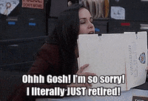
Budget Assistance
Administrators’ Days
July 28th & July 29th
8 a.m. – Noon
1 p.m. – 4 p.m
Ruby room 2nd floor Younes Center
Stop by and wish Janice Eret a Happy Retirement!

Slide 10
Budget Assistance
Call in to set up an appointment for budget help
or
Email in budget and set up a Zoom to discuss

Slide 11
Budgeting Reminders
Enter the correct State Aid Amount from State Aid Certification Document
Use Property Tax Resolution in budget document
Budget Spreadsheet pulls in levy info and percentage changes
County Treasurer’s Balance
Estimate from prior years
Beginning and Ending Balances
Use actual balances from audit
Second column of worksheet can be used to reach the desired levy.
Motor Vehicle Taxes
Similar to previous year

Slide 12
2021 Legislation
LB 528 – Requires each district to include in their hearing notice a link to the Nebraska Education Profile (NEP) website.
Provides information related to statewide receipts/expenditures
Compares cost per pupil and performance with other schools
https://nep.education.ne.gov/
LB 644 – Property Tax Request Act
Requires joint public hearing if increasing tax request more than 2.5% plus real growth
Requires post card/mailing sent to all property taxpayers
Changes filing date to September 30th
Goes into effect for the 22/23 budget.
LB 2 – Changes the valuation of Ag/Horticultural land for bond purposes
Ag/Horticultural valuations for bonding purposes are now 50% compared to 75% for other taxing purposes.

Slide 13
AFR Test Site
Upload test file into test site when available
Confirm coding used will be accepted by AFR System
Identify codes that are invalid
Contact us if you have questions about Invalid Code message

Slide 14
Clarification: Object Codes XX0 & XX6
XX0 Non-Instructional Staff
XX6 Professional Directors
Non-certificated professional & support staff
Work in non-instructional areas
Non-supervisory professional personnel
May hold a professional degree, license, certificate
Examples of job types:
Clerical Staff Kitchen Staff
Accounting Staff Custodial
Transportation Staff School Nurses
Clerical staff
Transportation staff
Kitchen staff
Custodial workers
Accounting clerk
Nurse
Non-certificated professional employees
Work in non-instructional areas
Include only individuals that direct/supervise departments
Holds a professional degree, license, certificate
Examples of job titles:
Business Mgr Tech Director
CFO HR Director
Network Admin Head Dietician

Slide 15
AFR Submission – November 1
AFR System Opens October 1
Utilize the AFR System Reports to confirm financial information aligns with audit
Financial Info submitted must align with audit
Notification to district to adjust/correct info
Financial Information must be uploaded again
In the fall, upload as soon as possible to avoid the rush close to deadline

Slide 16
AFR Reports Display Page
NEW Report – SPED Expenses Qualifying for State Reimbursement (FFR eligible)

Slide 17
Reimbursement and Monitoring Updates

Slide 18
Reimbursement
July 1st -- New Reimbursement Process Implemented
Submit your reimbursement as always. Accounting detail must be attached to support claim.
A reimbursement claim person will reach out to you if they need more detail.
Based on risk assessment developed by the department will determine the level of documentation required for reimbursements.

Slide 19
Monitoring
Monitoring will be for all grants awarded to the subrecipient for the year chosen.
Please ensure you keep separate files and documentation for each grant awarded.
Based on risk assessment developed by the department will determine how often you are monitored.
If noncompliance is discovered, NDE will do its best to issue a funding with corrective action that will be followed up. This follows Federal guidance 2 CFR 200.338

Slide 20
Monitoring Common Errors
Time and effort
Most common error we find is entities appear to use budgeted and not actual, T&E is actual time worked and paid for all activities.
Second most common error we find is entities charging salary only to a grant. This is unable per 2 CFR 430 and 431
Last error we find is claims for reimbursement not matching accounting records
Policies and Procedures
Most common error is entities do not have all the required policies and procedures for grants. Need policies and procedures for the following; Equipment and inventory, Procurement, Record retention , Suspension and Debarment, Financial Management, Program Income, Cost sharing or matching, and Compensation – Personal services and fringe benefits
Coding Issues
After a reimbursement is paid the allowable expenses are moved which then makes them unallowable.

Slide 21
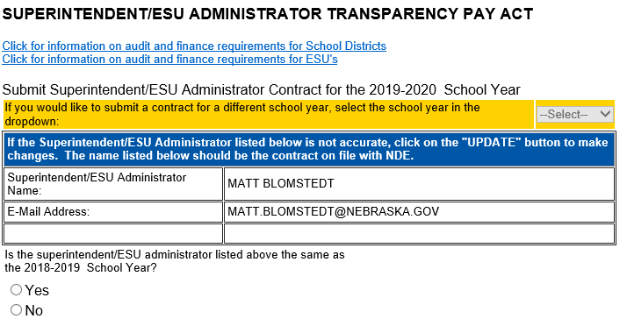
Superintendent Transparency Act
Superintendent Contract for 2021/22 must be on file with NDE by August 1
Upload through CDC in the NDE Portal
NDE Help Desk 1-888-285-0556

Slide 22
Masks requirement for buses???
PUPIL TRANSPORTATION
There is disagreement/confusion at the National level if this is a requirement……

Slide 23
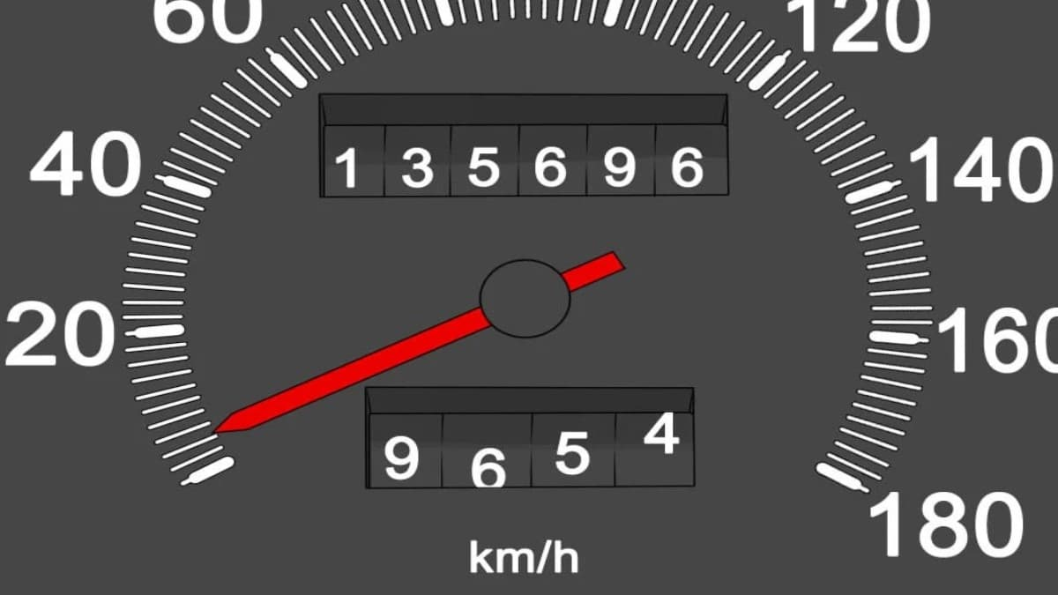
Pupil Transportation Reimbursement
Mileage Reimbursement Calculation:
To qualify, must live 4 miles from school but mileage reimbursement is paid from 3 miles
Based on one-way travel once a day
Resident Students:
$1.596/mile State Mileage Rate x 285%
Option Students:
Must qualify for free lunch to receive mileage reimbursement
$.798/mile State Mileage Rate x 142.5%

Slide 24
American Rescue Plan Act Allocations
ESSER III
LEA’s portion = $491 Million
Obligation period March 13, 2020 Sept 1, 2020 – Sept 30, 2024
Allocations available on ESSER website
2nd Part of Application available July 15th
20% must be used to address Learning Loss
Davis Bacon requirements apply to construction projects in excess of $2,000

Slide 25
Response and Relief Act Allocations
ESSER II
LEA’s portion = $218.8 Million
Obligation period March 13, 2020 Sept 1, 2020 – Sept 30, 2023
Davis Bacon applies to construction projects in excess of $2,000
Capital projects require prior approval

Slide 26
Slow Down!!!

Slide 27
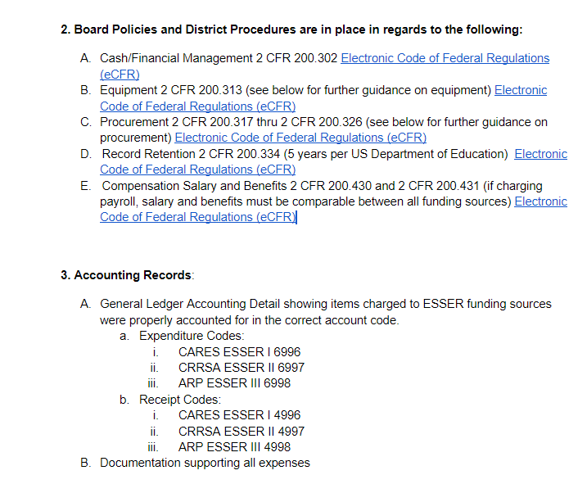
Monitoring Checklist
ESSER Fund Monitoring checklist
Will be available on the ESSER website.
Should be used while in the planning/budgeting phase

Slide 28
MOE – Maintenance of Equity
Reduce per-pupil funding (from combined State and local funds) for any high-poverty schools served by such LEA by an amount that exceeds the district average reduction in funding per student.
Reduce per-pupil, full-time equivalent staff in any high-poverty school by an amount that exceeds the district average reduction in staff.
Exceptions – Shall not apply to LEAs that meet at least one of the following criteria:
Less than 1,000 students
Operates in a single school
Demonstrates and exceptional or uncontrollable circumstance

Slide 29
State Budget
Recommendation: Include the ESSER funds in your State Budget
Spending Exclusion - Included in Special Grant Fund List
Does not require you to spend them during the 2021/22 school year

Slide 30
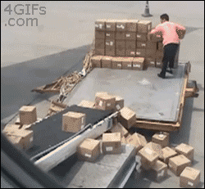
New Location
Physical Address:
500 S 84th St., 2nd Floor
Lincoln, NE 68510-2611
Mailing address:
PO Box 94987
Lincoln, NE 68509-4987

Slide 31
Follow Bryce on Twitter
bryce wilson@NDE_Finance
School finance related reminders
Upcoming school finance due dates
Legislative updates

Slide 32
NDE School Finance Team
Bryce Wilson
bryce.wilson@nebraska.gov 402-471-4320
Kevin Lyons
kevin.lyons@Nebraska.gov 402-450-1418
Janice Eret – Short Timer
janice.eret@nebraska.gov 402-540-0649
Michelle Cartwright
Michelle.cartwright@nebraska.gov 402-450-0867
Stephanie DeGroot
stephanie.degroot@nebraska.gov 402-540-0649
(After Janice Retires)
Notes:
RUSS END

